Slide 1
Fundamental Algorithms I
Linden Lu

Slide 2
Module 2: Fundamental Algorithms I
Linear Regression
Logistic Regression
Decision Tree

Slide 3
Module Objectives
Understand how the three algorithms work
Apply the three algorithms with python code
Understand the key model hyperparameters
Understand basic model evaluation metrics

Slide 4
Introduction to Linear Regression
Linden Lu

Slide 5
Linear Regression
Supervised Learning
Predict continuous output
Assume linear relationships between input and output
Feature scaling is normally not needed

Slide 6
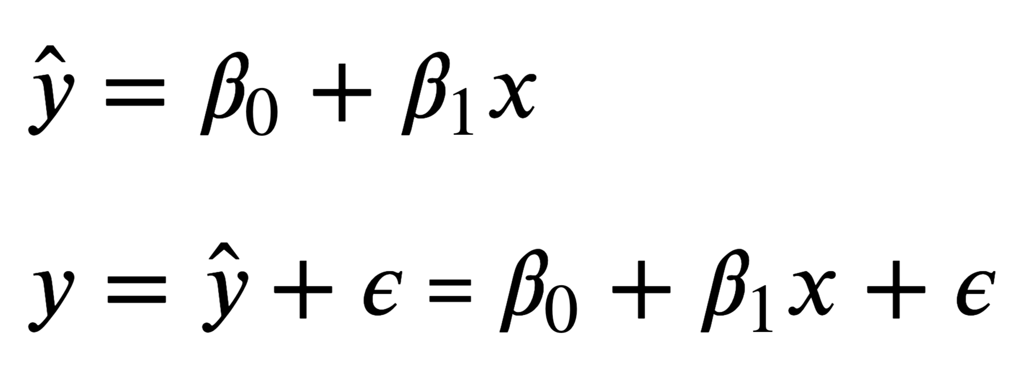
Simple Linear Regression

Slide 7
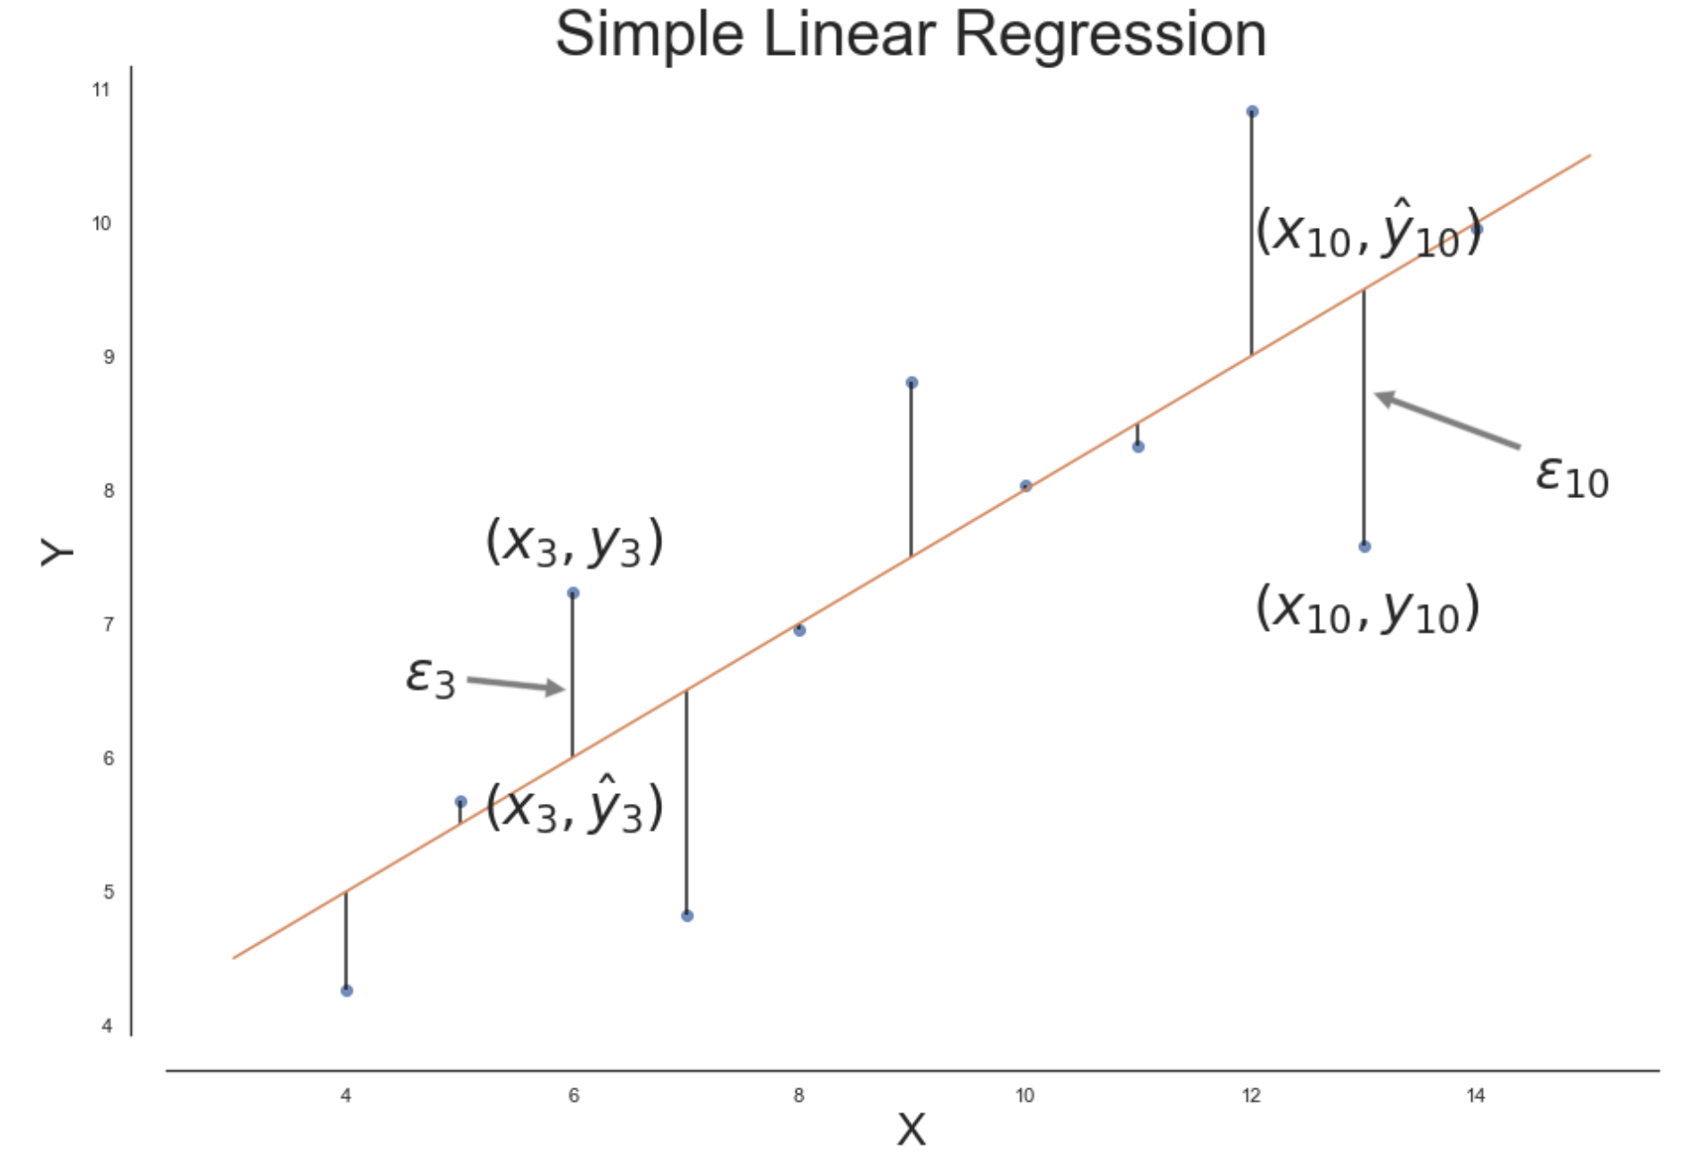
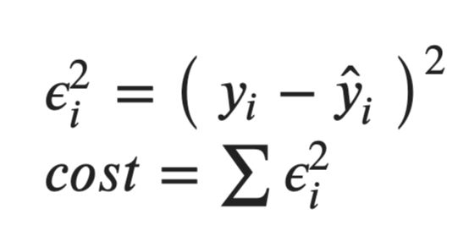
Cost Function

Slide 8
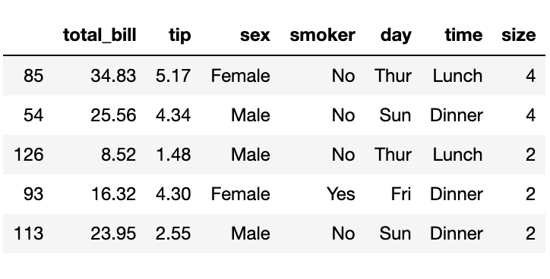
Tips Dataset

Slide 9
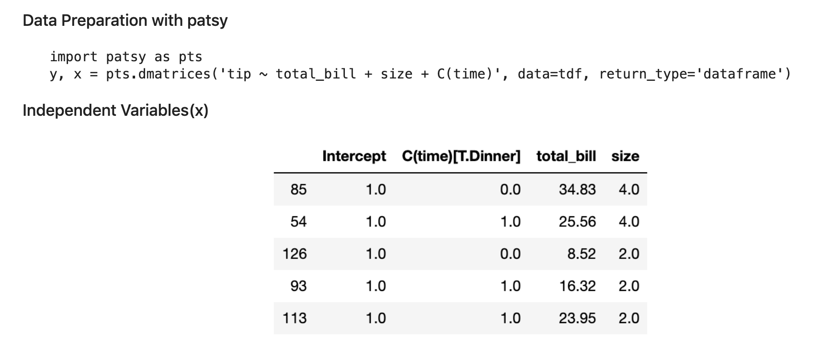
Data Preparation

Slide 10
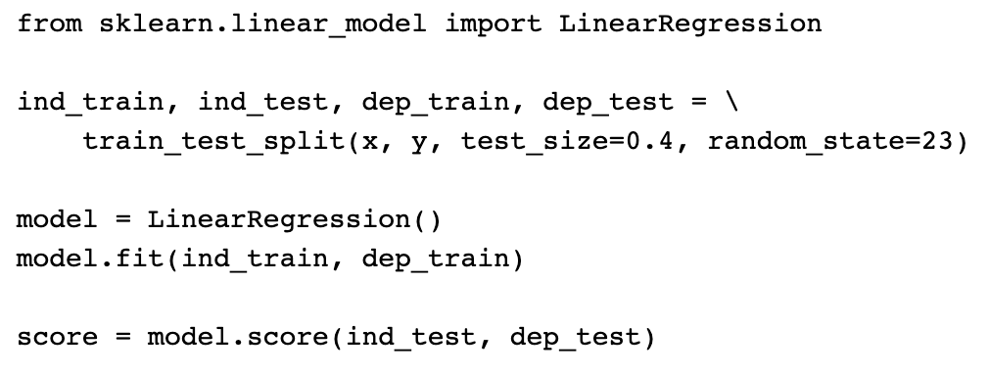
Scikit Learn LinearRegression Model

Slide 11
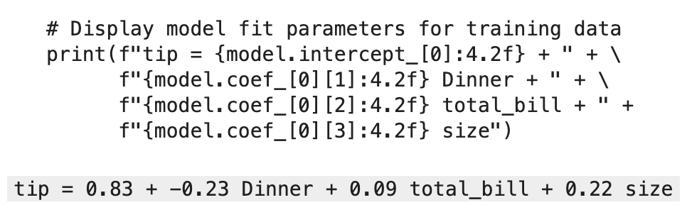
Linear Regression Formula

Slide 12
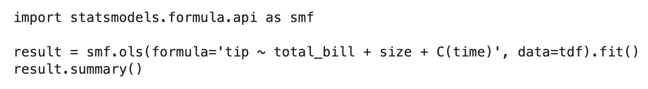
Statsmodels Linear Regression

Slide 13
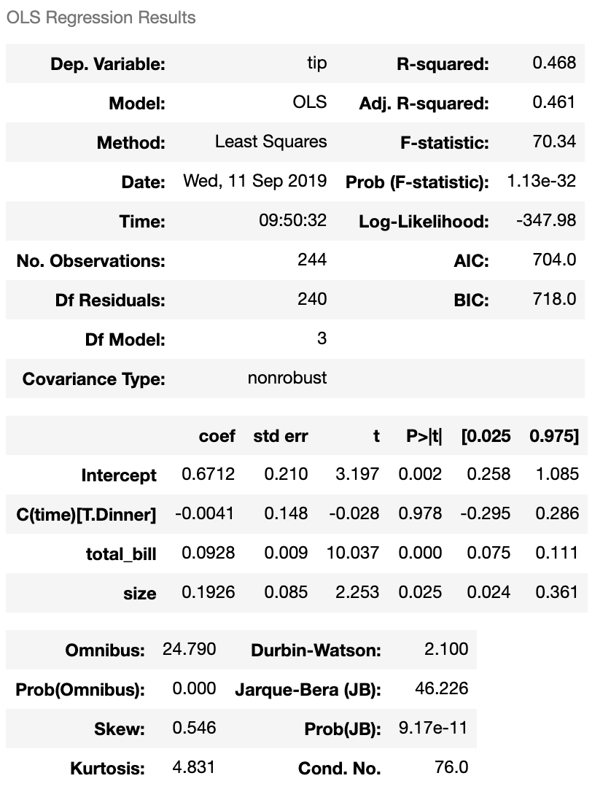
Linear Regression Result

Slide 14
Introduction to Logistic Regression
Linden Lu

Slide 15
Lesson 2: Logistic Regression
Supervised learning
For classification problems
Feature standardization preferred

Slide 16
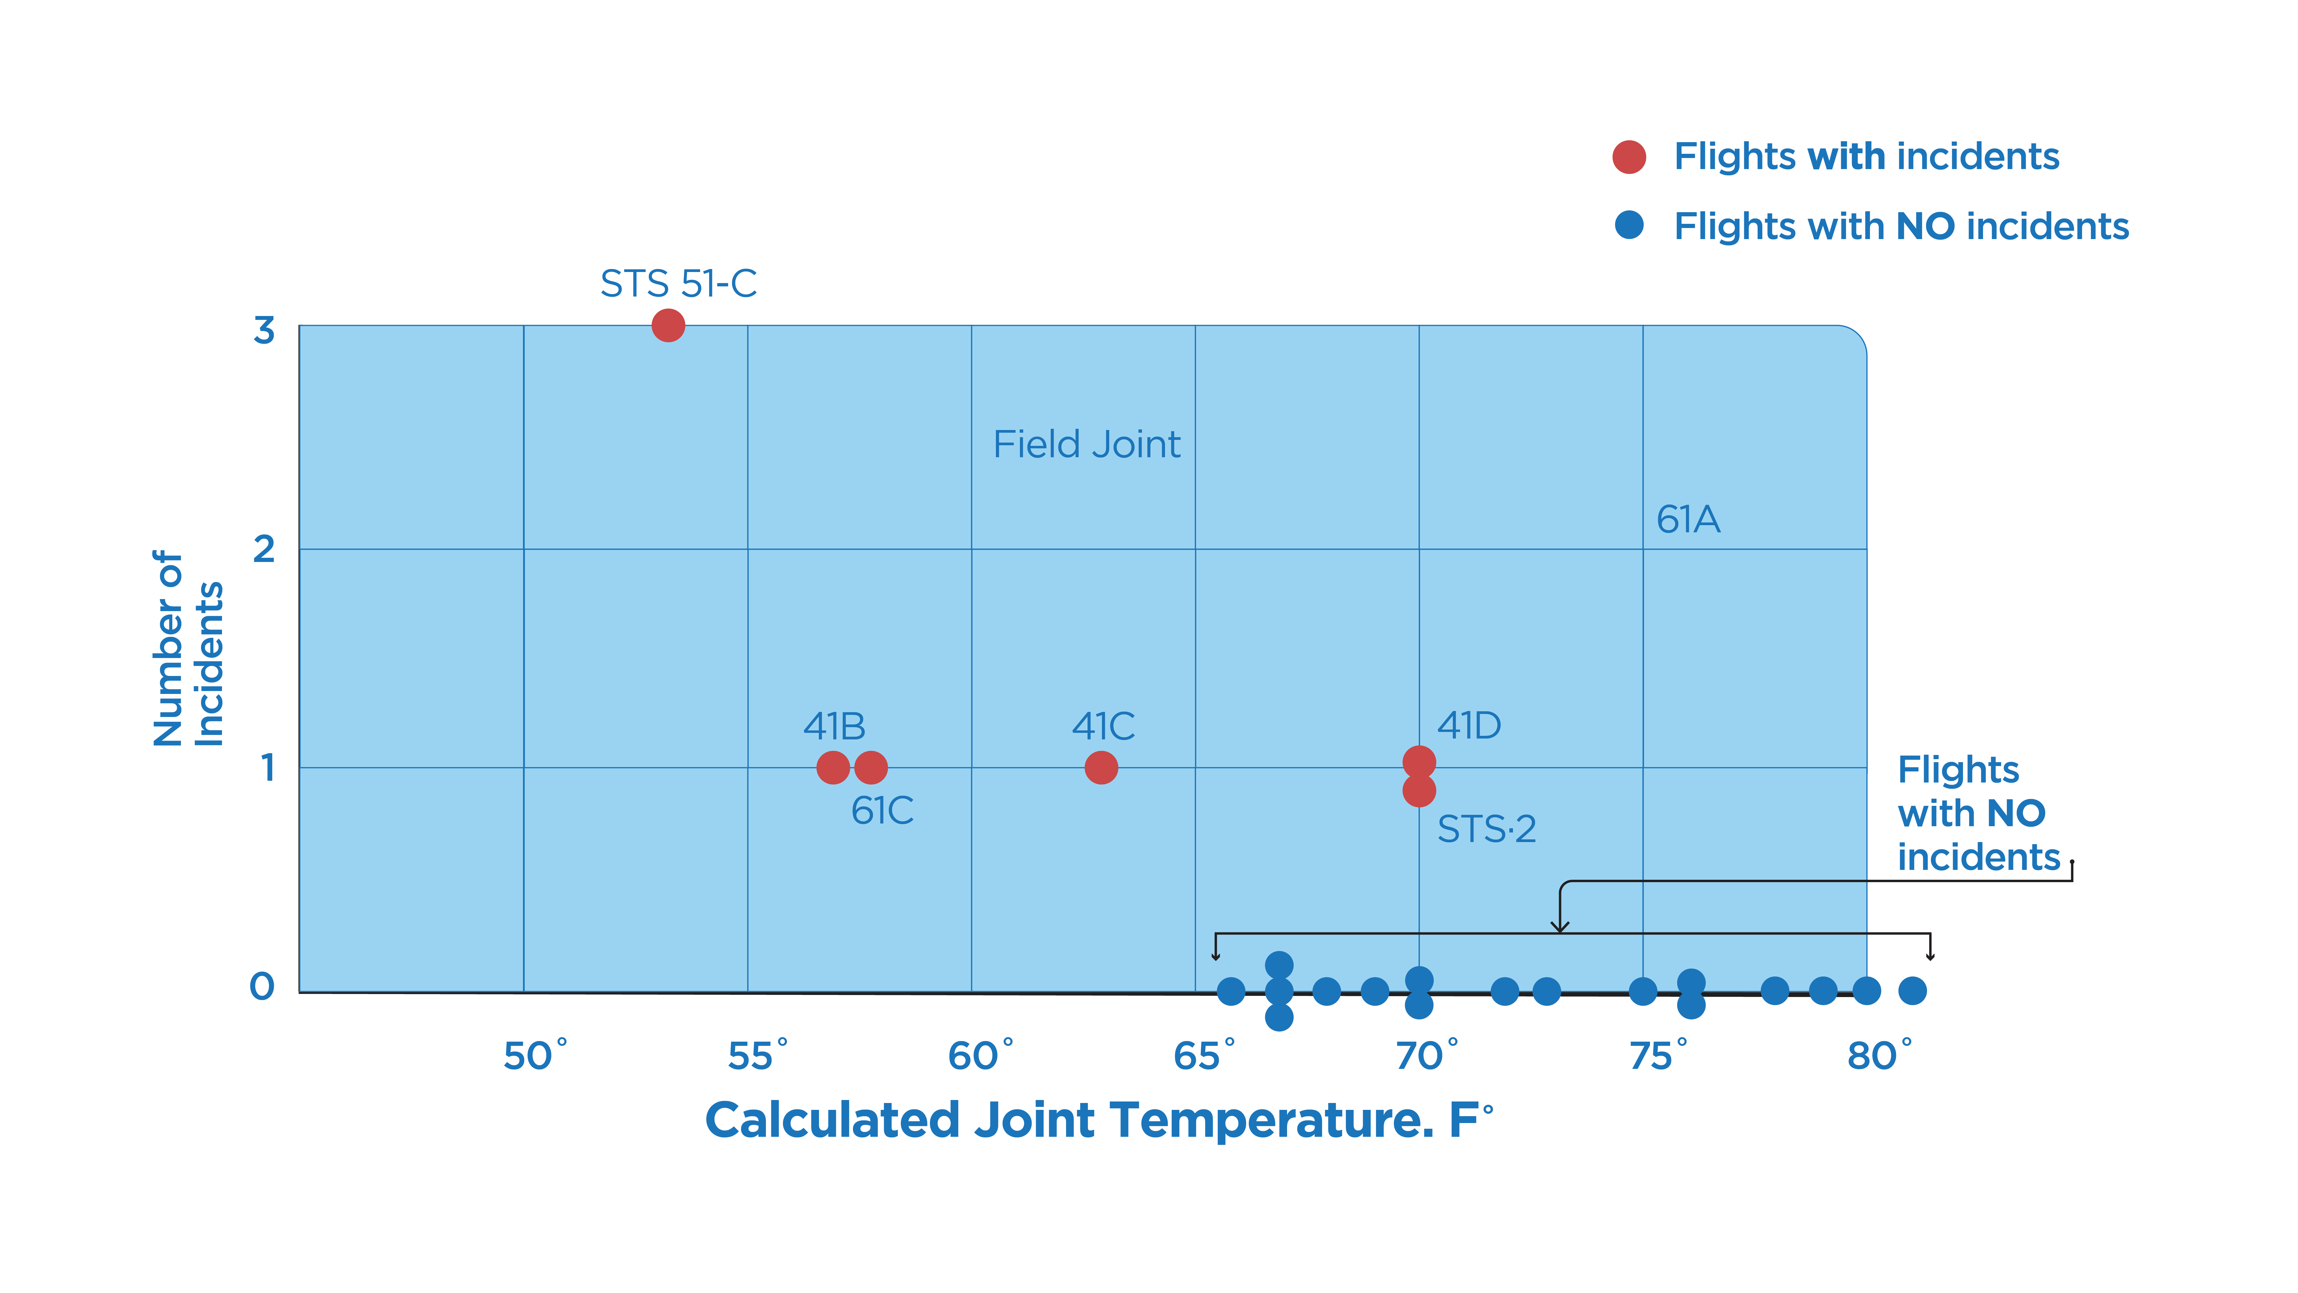
Challenger Disaster Investigation

Slide 17
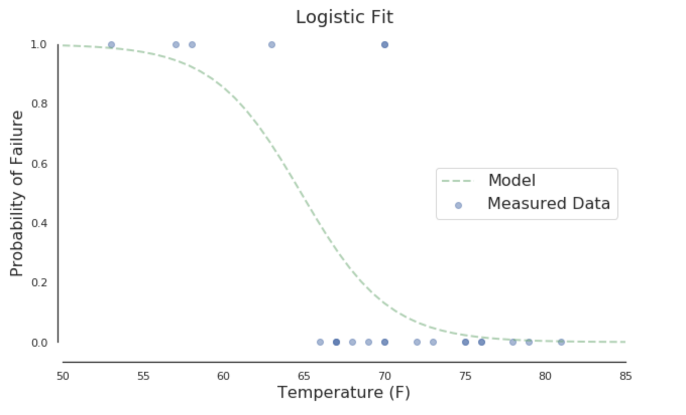
Map to Probability

Slide 18
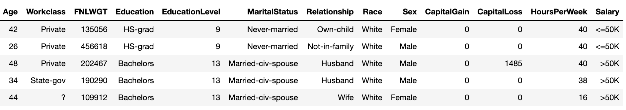
Adult Income Dataset

Slide 19
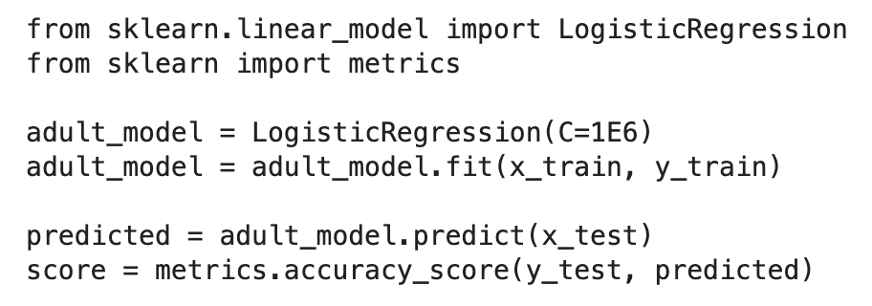
Scikit Learn LogisticRegression model

Slide 20
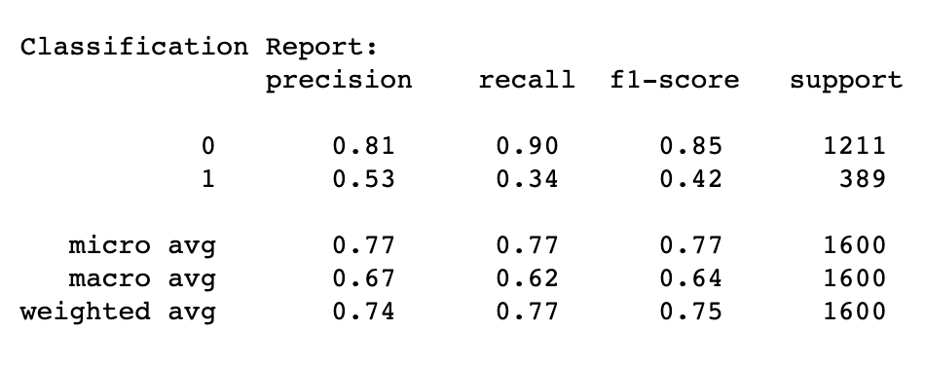
Classification Report

Slide 21
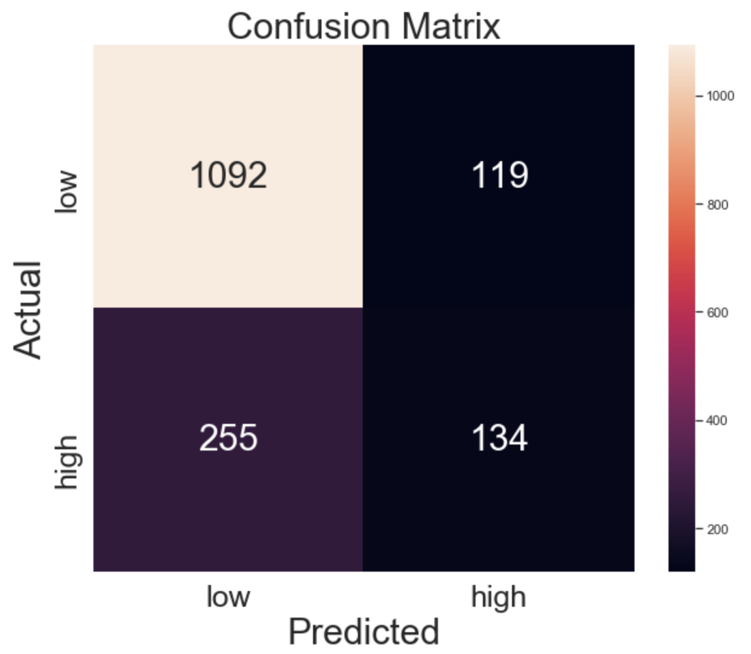
Confusion Matrix

Slide 22
Introduction to Decision Tree
Linden Lu

Slide 23
Lesson 3: Decision Tree
Supervised learning
For both classification and regression problems
Can handle categorical feature(numerical)
Feature scaling is not needed

Slide 24
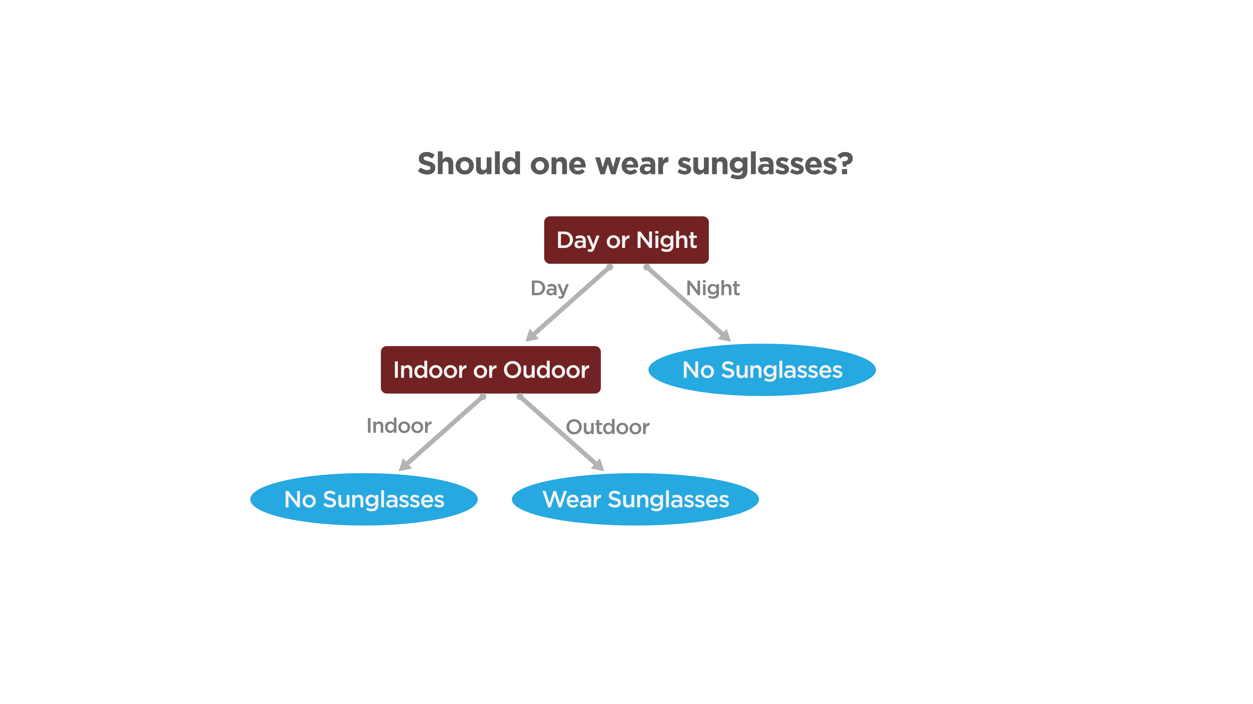
Decision Tree

Slide 25
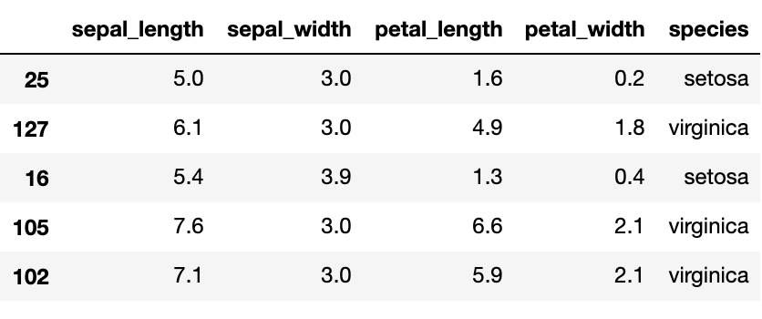
Iris Dataset

Slide 26
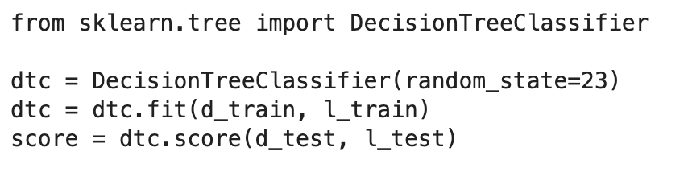
Scikit Learn Decision Tree Classifier

Slide 27
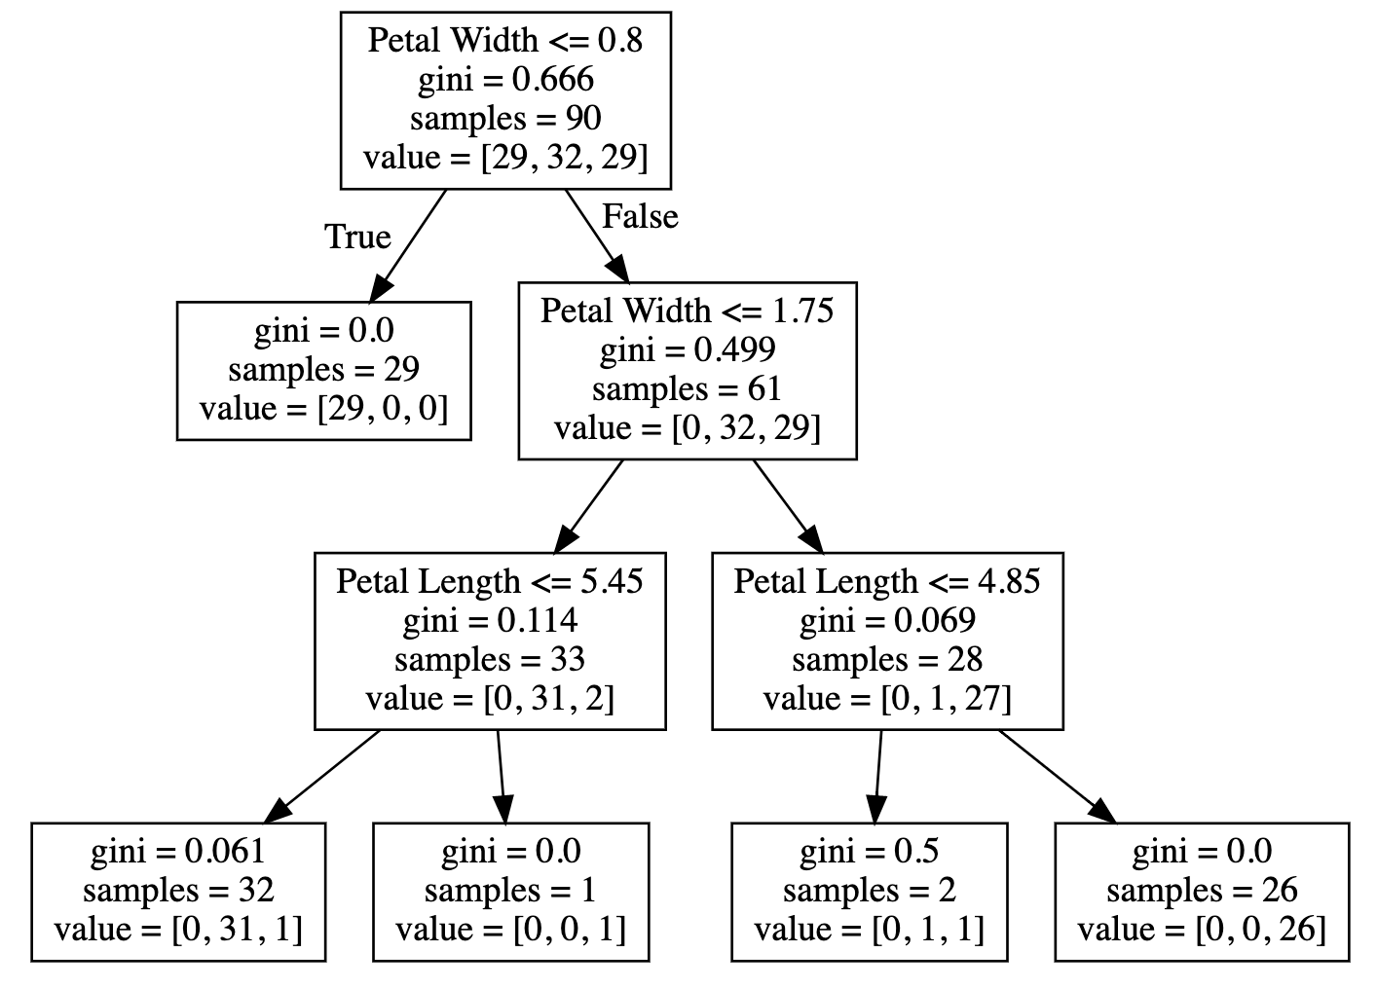
Visualize Decision Tree

Slide 28
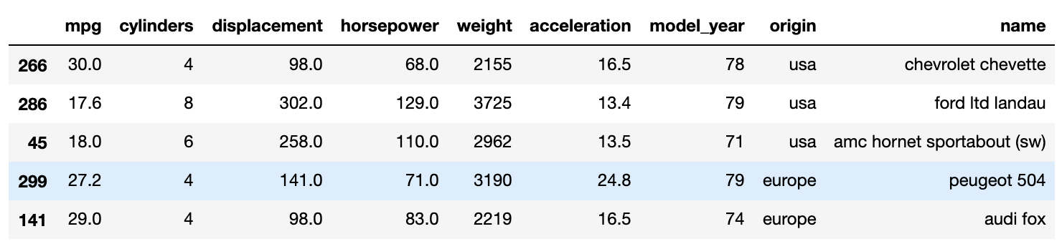
Auto MPG Dataset

Slide 29
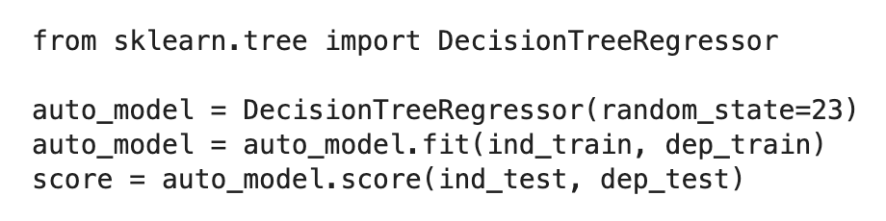
Scikit Learn Decision Tree Regressor

Slide 30
Module 2 Review
Linear Regression
Logistic Regression
Decision Tree

Slide 31
Module 2 Review
Continuous Features
Scaling not needed
Categorical Features
Create dummy variables
Linear Regression
Logistic Regression
Label encoding
Decision Tree

